Slide 1
Arimaiciai lake and Verdenes spring

Slide 2
Arimaičiai Lake
Facts:
It’s not all natural, but man made
It’s the biggest lake in Radviliškis Region
The average depth is 2,0 meters
The whole area is 2,873${km}^{2}$
The deepest part is 18,7 m

Slide 3
Verdenės Spring
Facts :
The water is coming from the ground level
It becomes a river while flowing
It has a taste of a swamp
Radviliskis people use the water for making food
The water comes from a small mountain

Slide 4
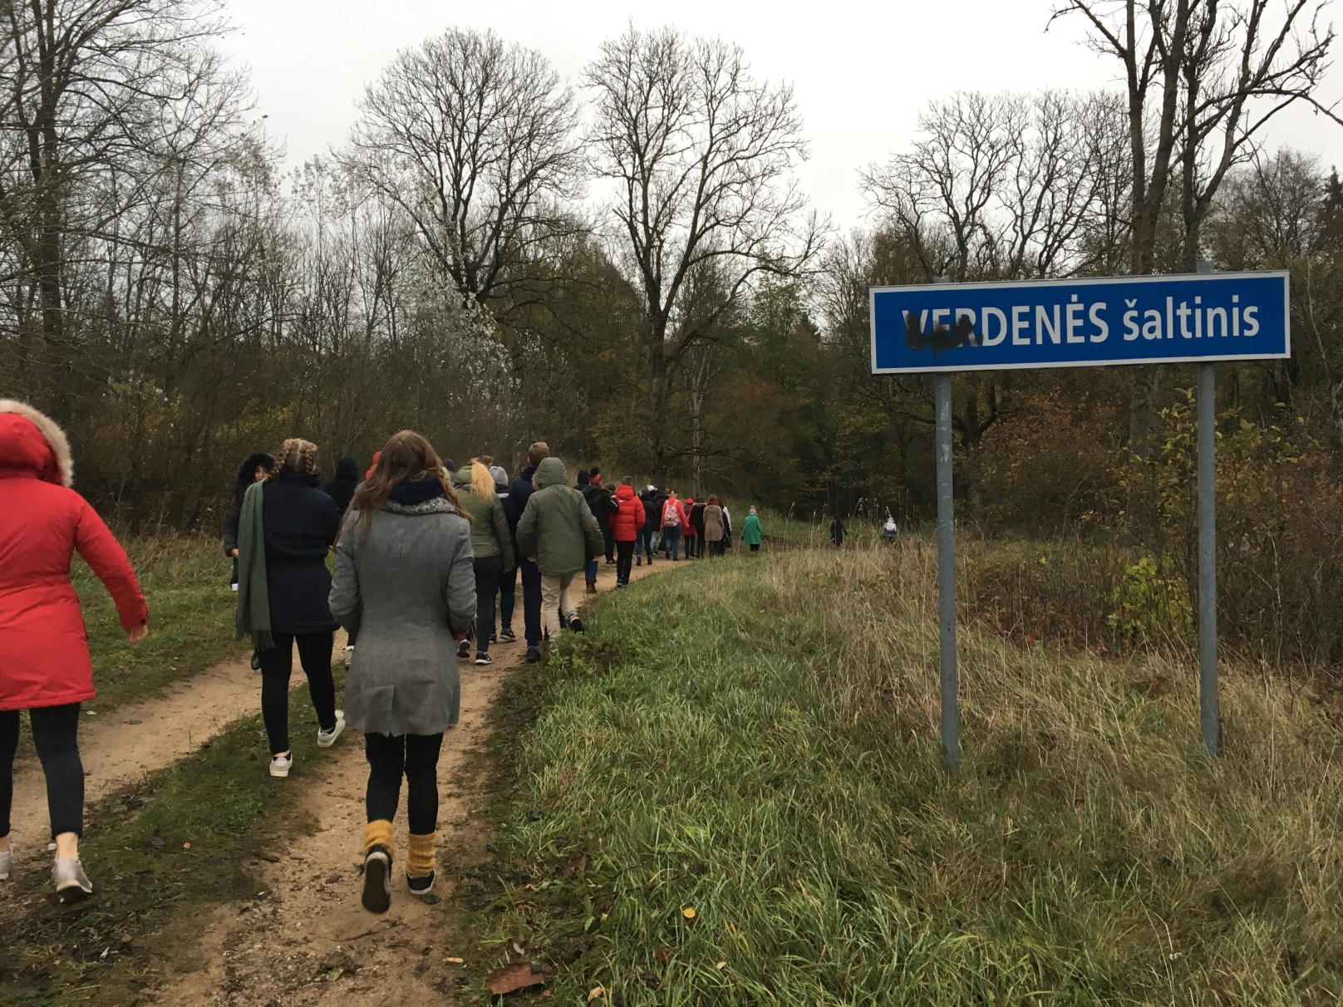
Our visit to Verdenės Spring :

