Slide 1
Kaunas Water Enterprises
Ksenia Tsavelidze, Mykolas Peleckis, Indre Martyna Pilipaityte, Heli Mäki

Slide 2
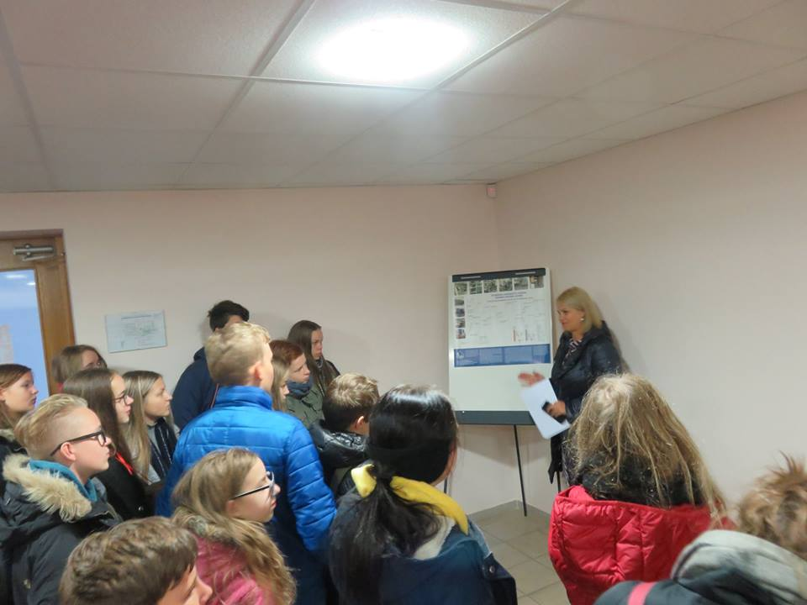
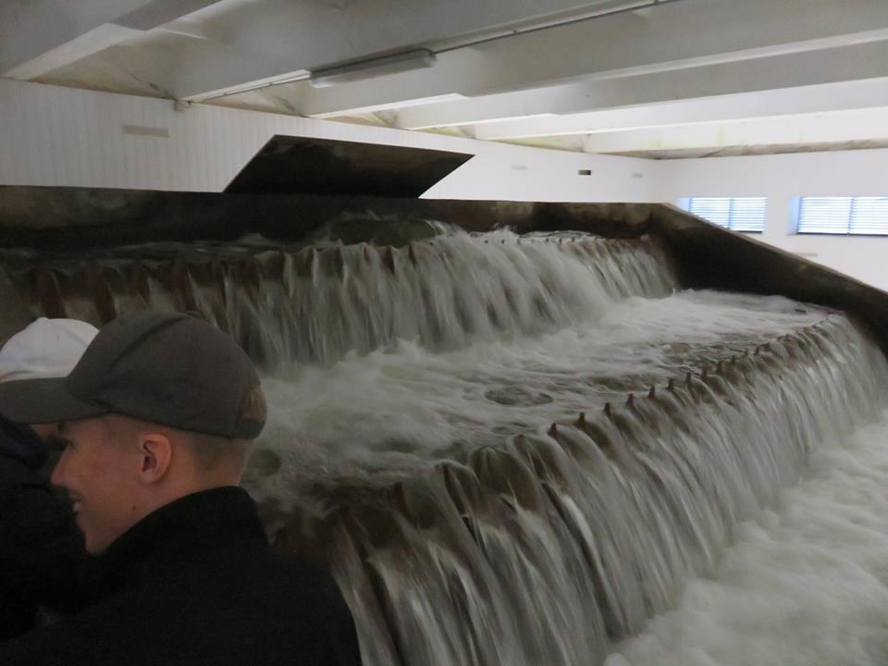
Water improvement equipment
We saw how water is being cleaned and we saw how water is going to the people.

Slide 3
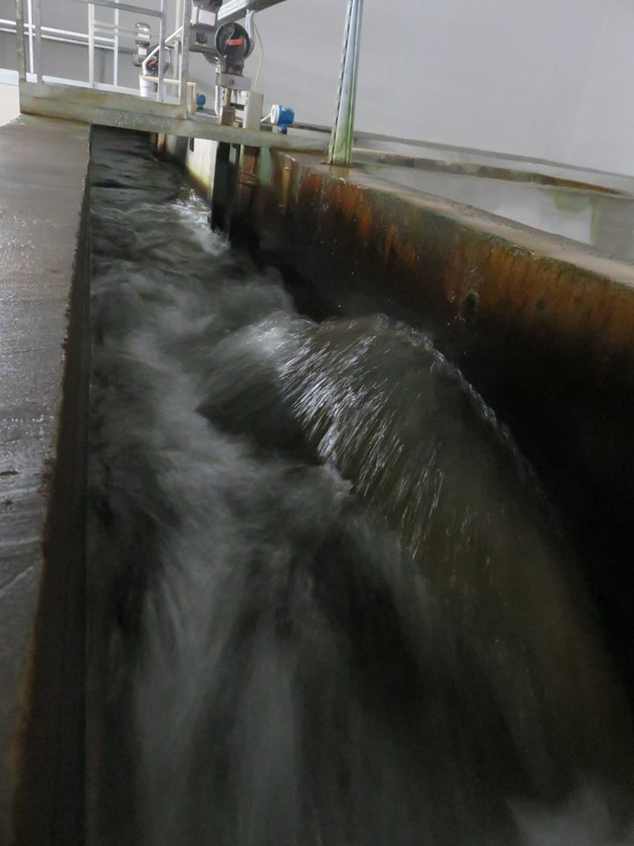
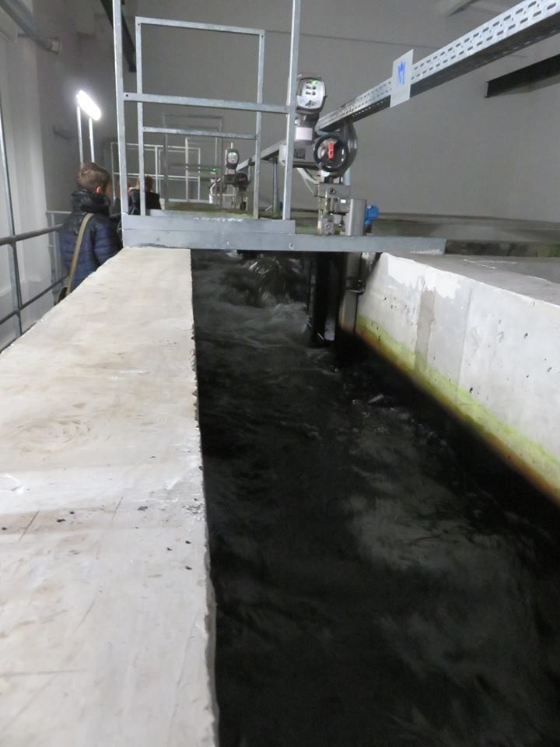

Slide 4
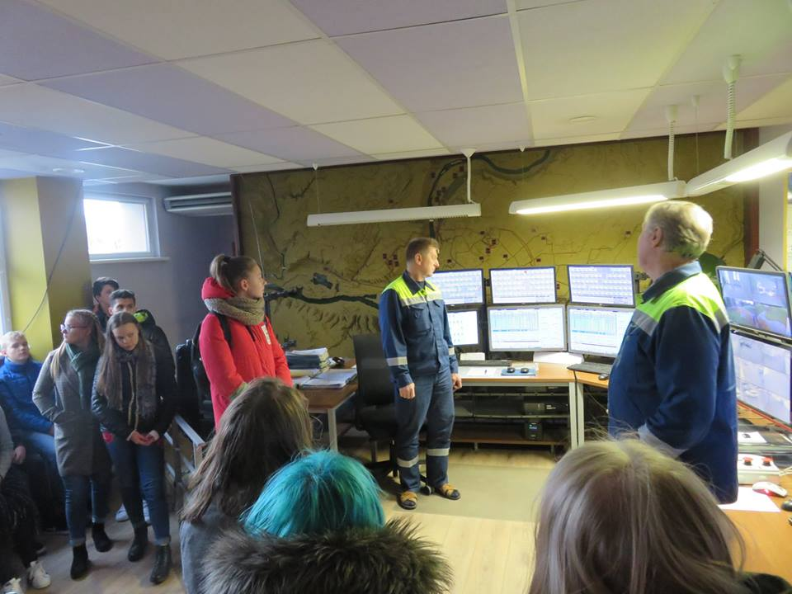
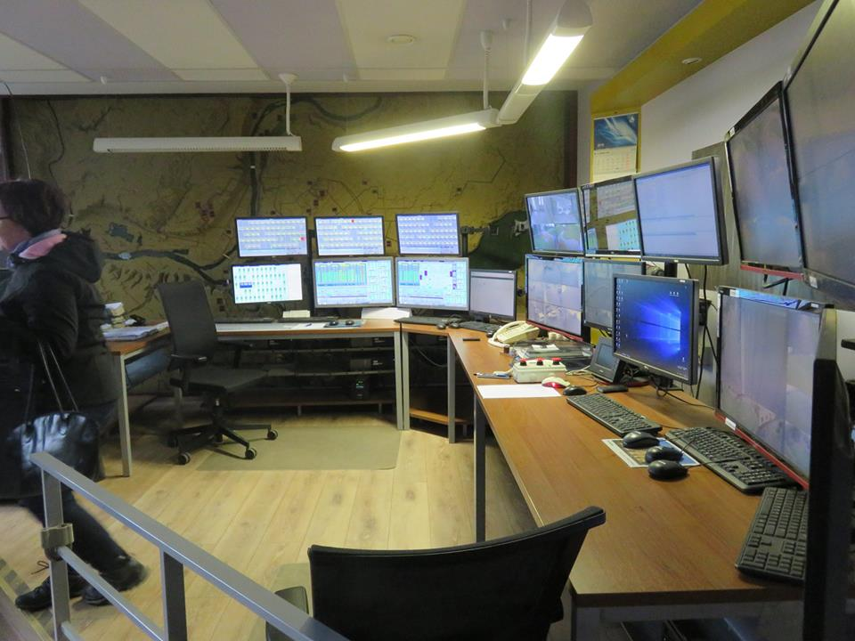
Control Room
We saw how men control the pumps.

Slide 5
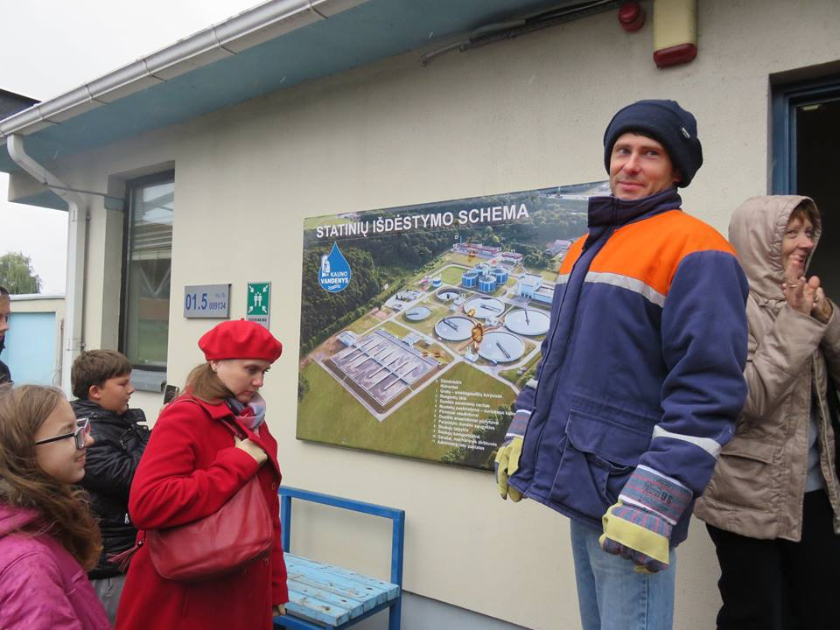
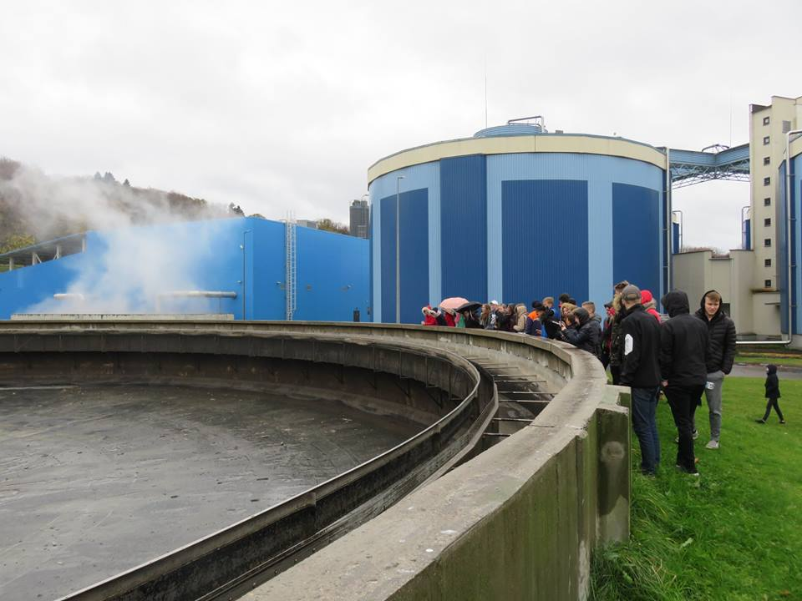
Wastewater treatment plant
We saw how workers make the water cleaner. There was a bad smell of dirty water, but it didn’t ruin our day☺

Slide 6
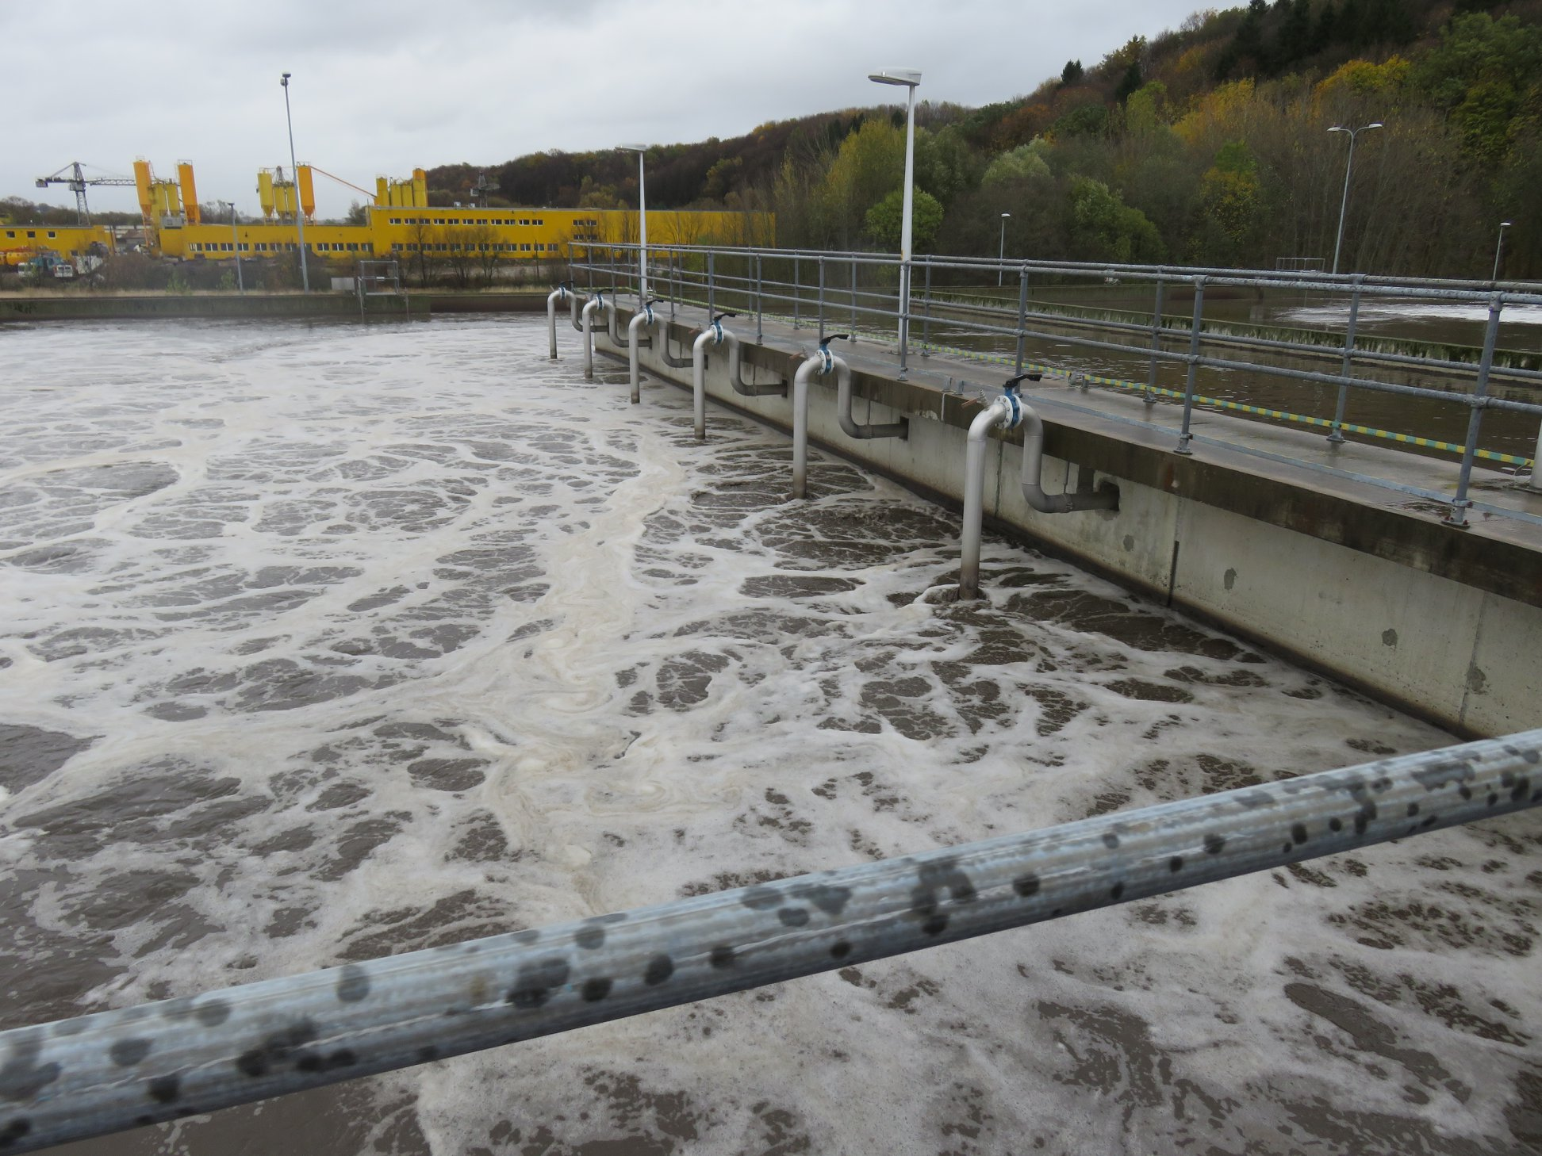

Slide 7
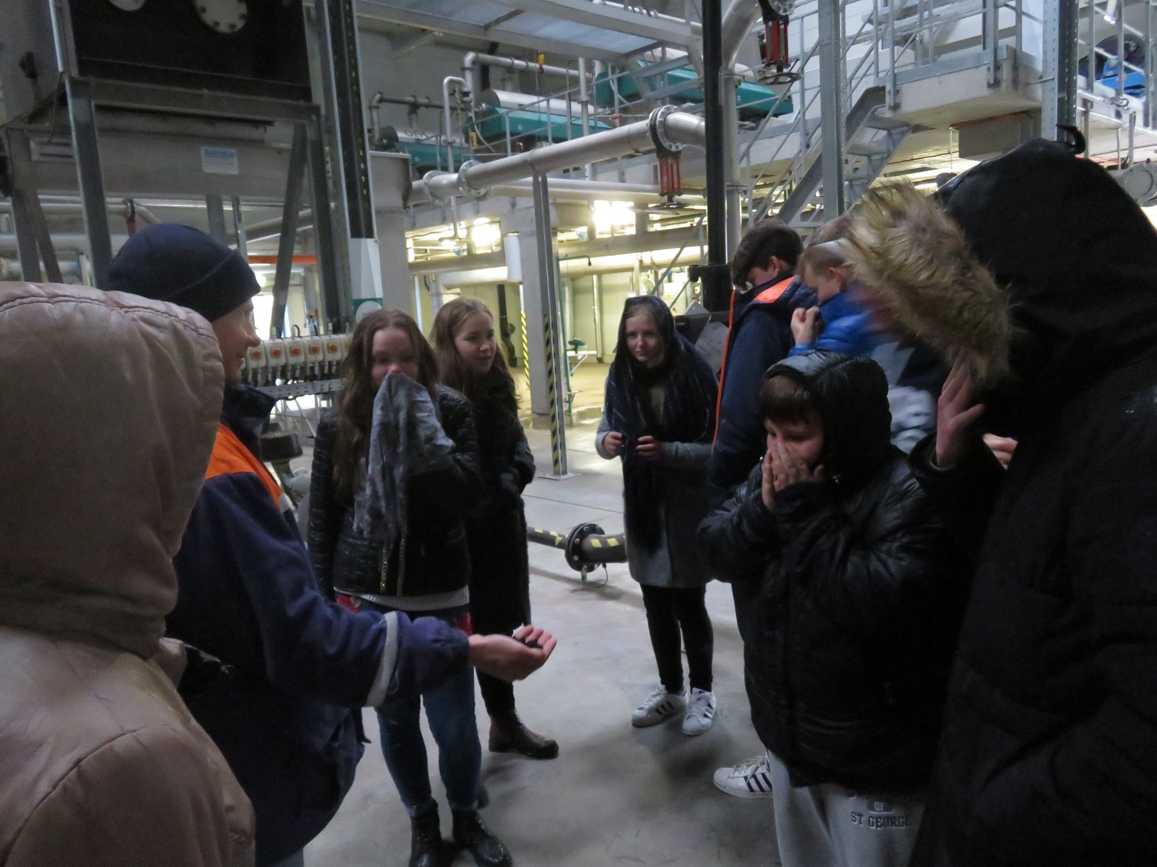

Slide 8
