Slide 1
Water enterprises in Radviliškis
Gileta
Sakarias
Alex
Giedrė

Slide 2
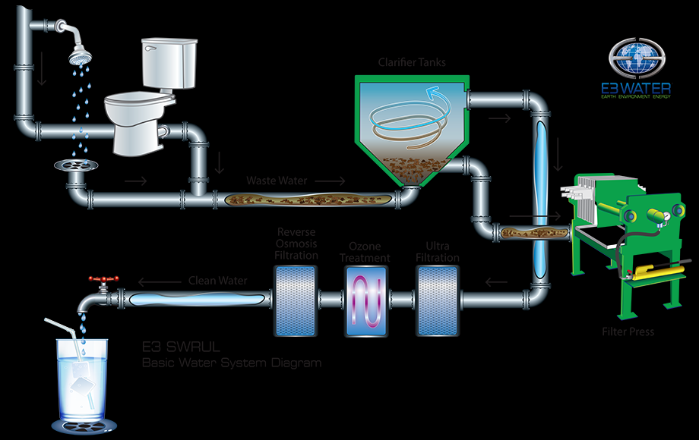
Water cleaning system
capable of discharging sterile and pathogenic free (of identifiable bacteria and viruses) water and will provide clean sterile water through a proprietary cleansing process
clean water discharge standards by producing sterile water and sterile sludge

Slide 3
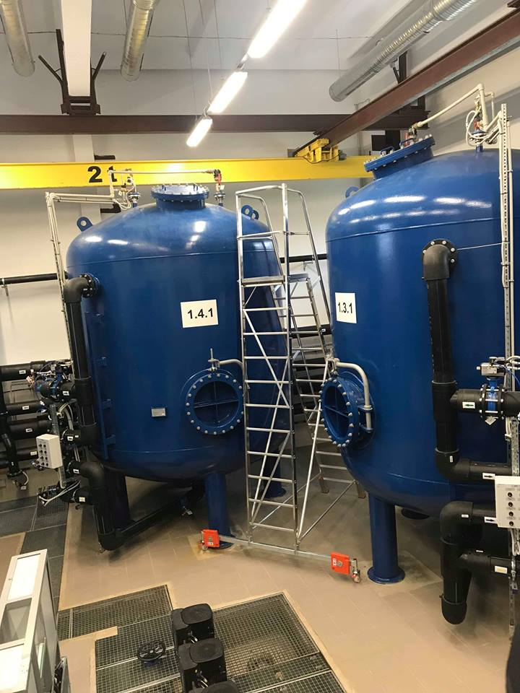
Water containers
Water pumps
Sand is mixed there with dirty water
Cludge settles down in the bottom of the containers
That space is really cold

Slide 4
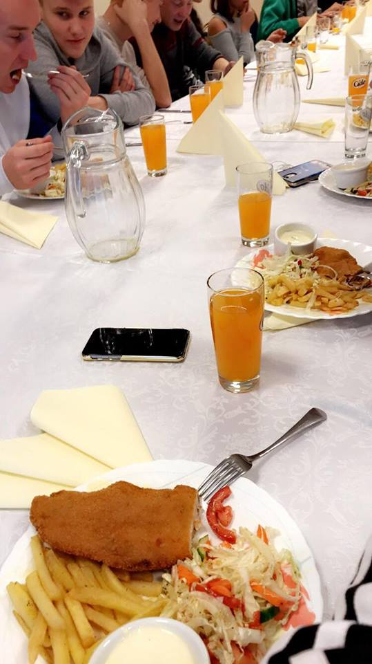
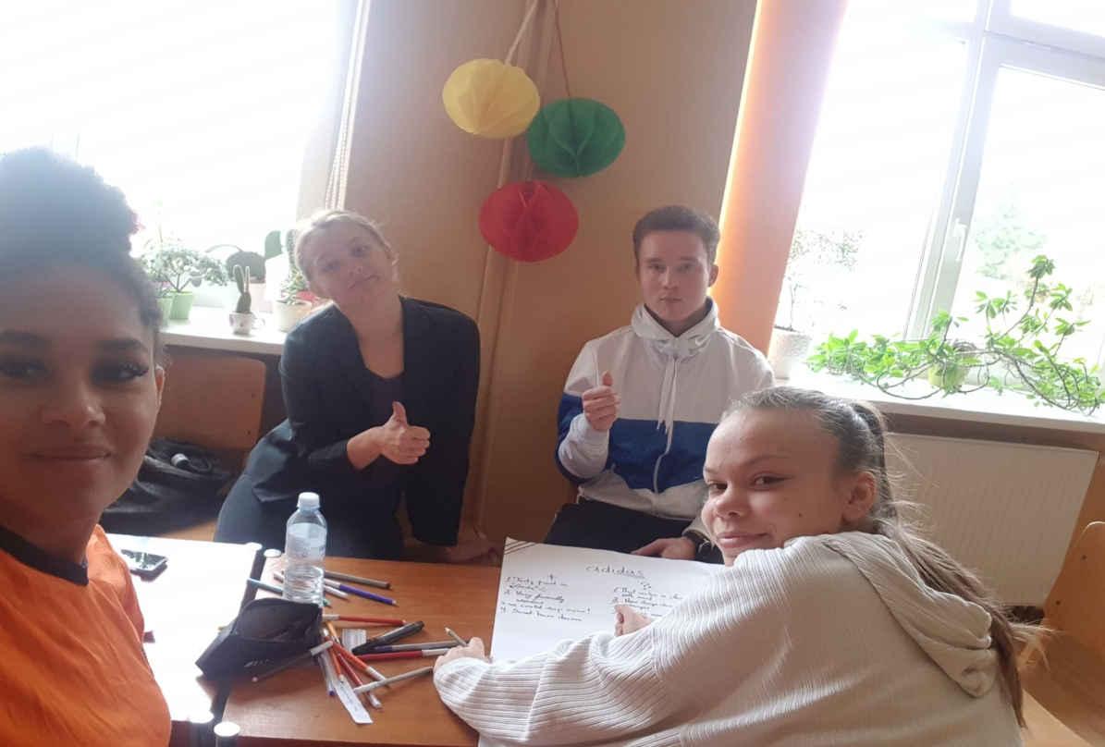
Whats new
Cleaning method with sand
Water pumps purpose
How much water can pumps handle
Lithuanian food is new for us too

Slide 5
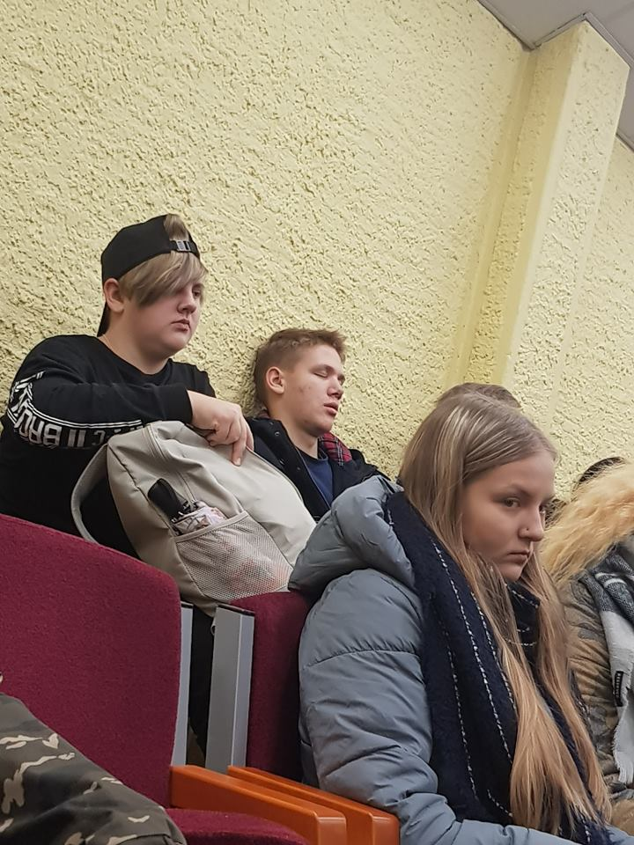
Lecture in Radviliškis municipality building
It was interesting but kind of hard to understand
We were a little bit sleepy
And it was shoking how such a small village can use such a big amount of water in one day

Slide 6
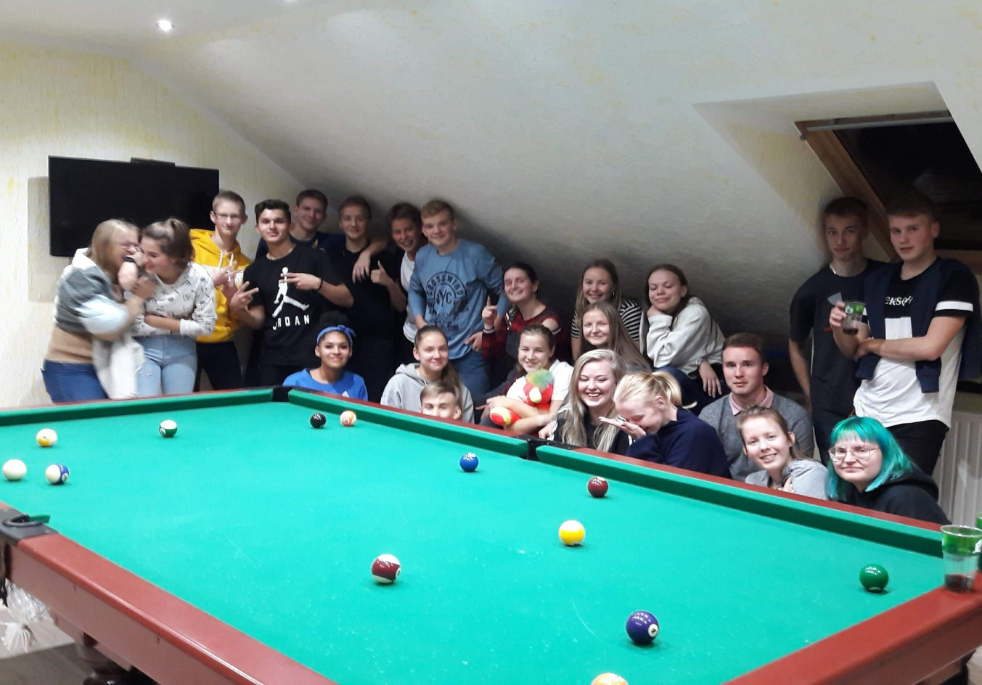
Thanks for the attention !
Ačiū
Kiitos
Aitäh

