Slide 1
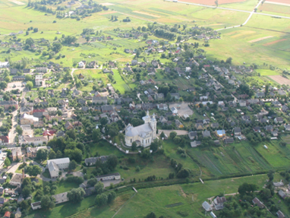
A GUIDED TOUR IN ŠEDUVA

Slide 2
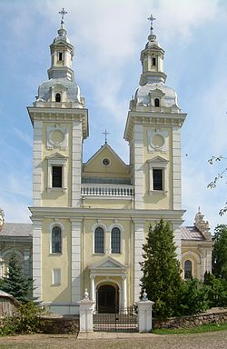
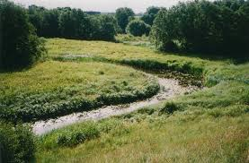
WHAT DID WE SAW IN ŠEDUVA
We saw the town, the river Niauduva, the church and the old houses, enterprise Lelija. And when we were walking the rain started.

Slide 3
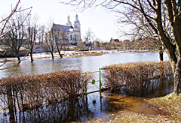
NIAUDUVA
It is the only river that flows through the town.

Slide 4
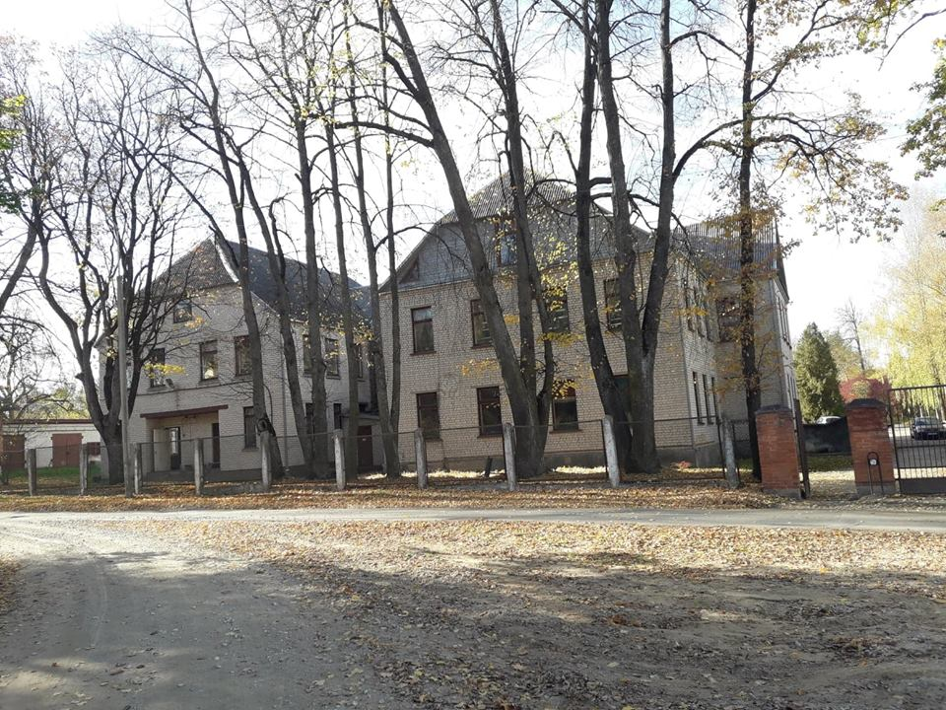
The Clothes factory ,,Lelija‘‘
There is enterprise Lelija in Šeduva that makes clothes. Clothes are ironed using steam. The enterprise uses water suply to get steam.

