Slide 1
Art lesson

Slide 2
Estonian artists
Martin Saar
Adamson-Eric
Maximilian Maksolly
Konrad Mägi
Eugen Dücker
Lydia Mei
Juhan Muks
Evald Okas
Richard Sagrits
Juhan Muks

Slide 3
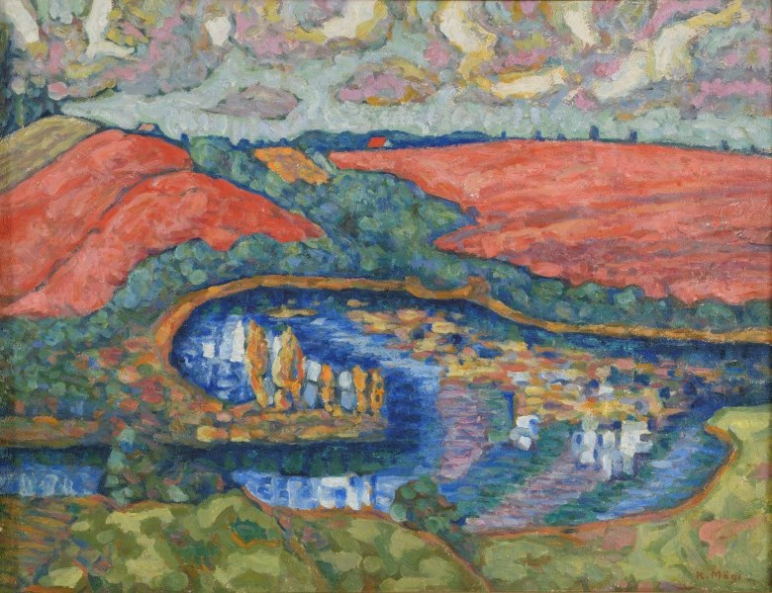
Konrad Mägi

Slide 4
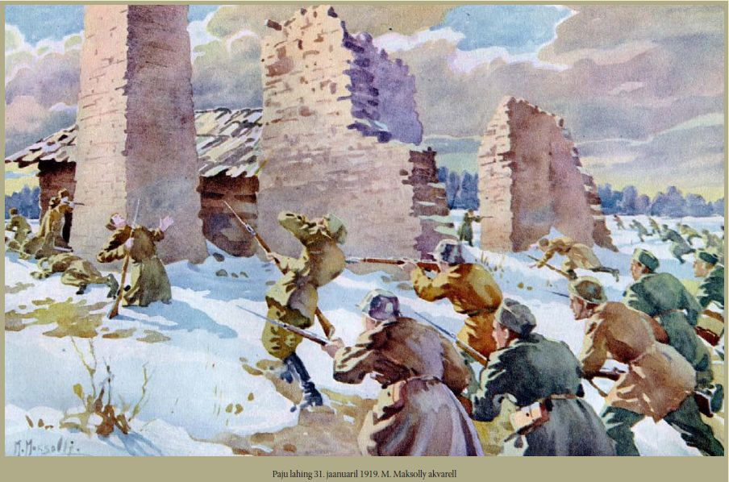
Maximilian Maksolly

Slide 5
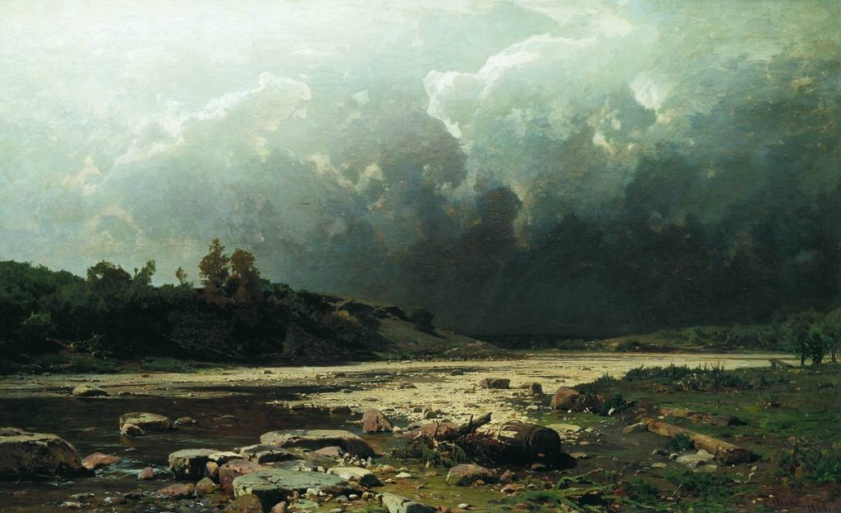
Eugen Dücker

Slide 6
Finnish Artists
Nandor Mikola
Minna L. Immonen
Marjukka Paunila
Carl Wargh

Slide 7
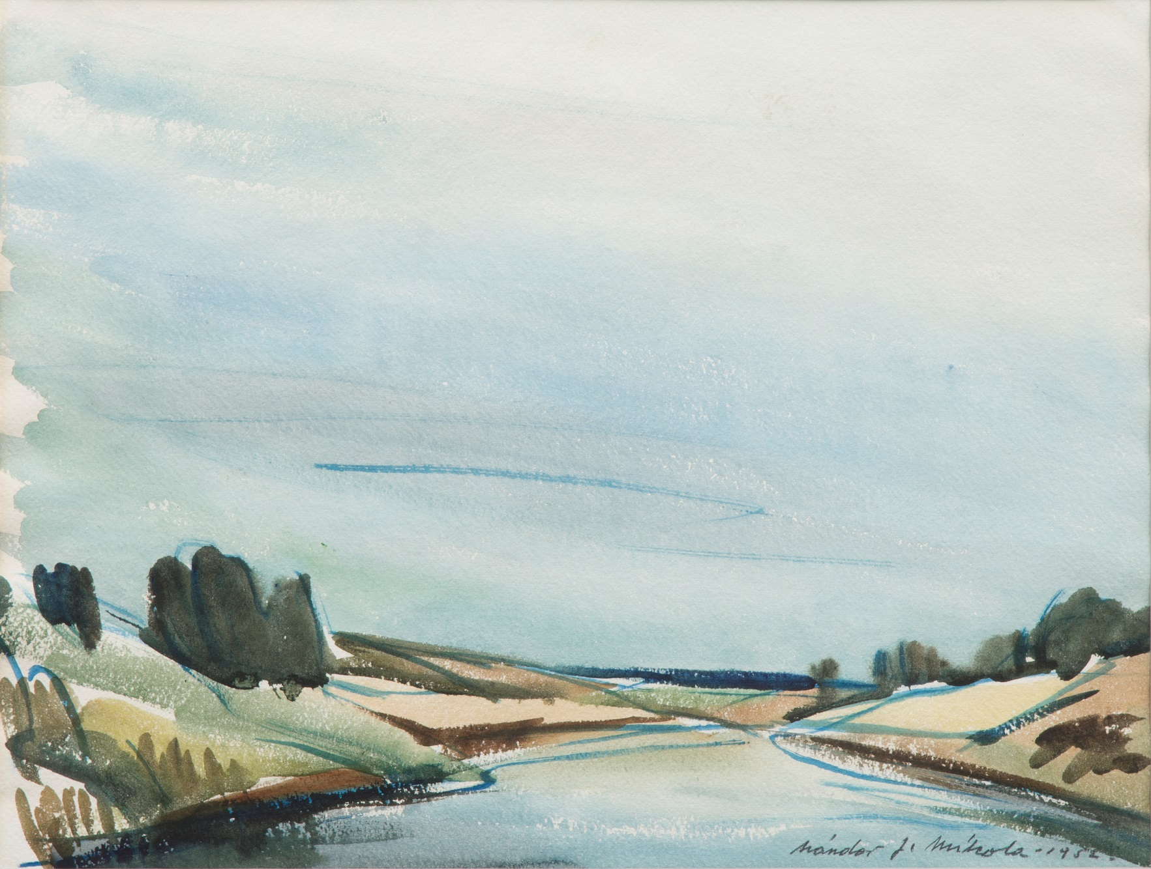
Nandor Mikola

Slide 8
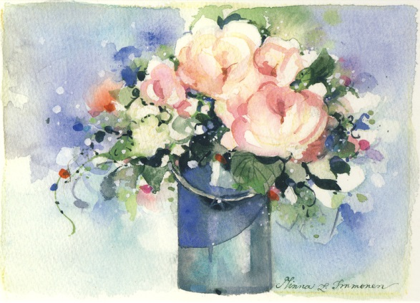
Minna L. Immonen

Slide 9
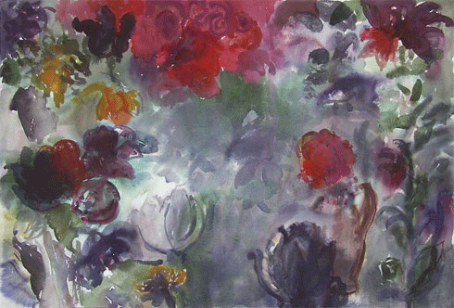
Marjukka Paunila

Slide 10
Lithuanian artists
Jurga Ryan
Petras Petrikonis
Antanas Petrikonis
Jonas Mackonis
Petras Kardokas
Greta Mockotė

Slide 11
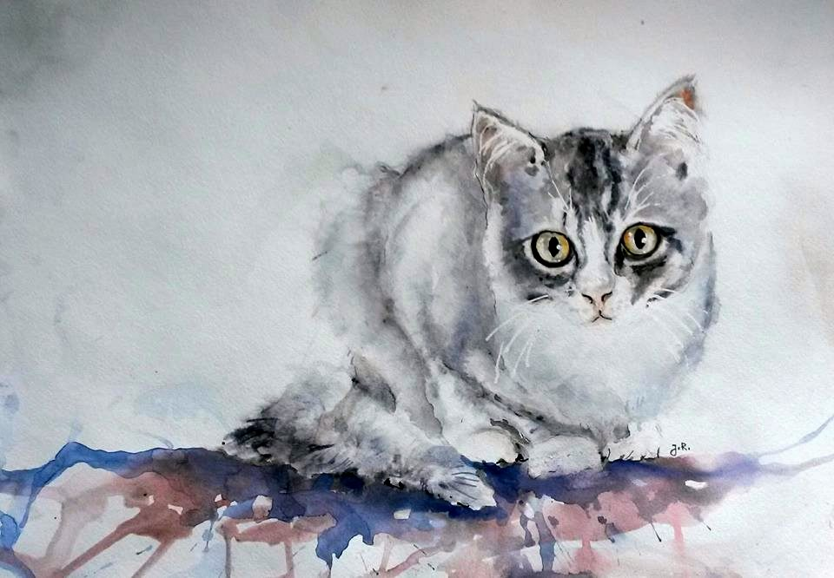
Jurga Ryan

Slide 12
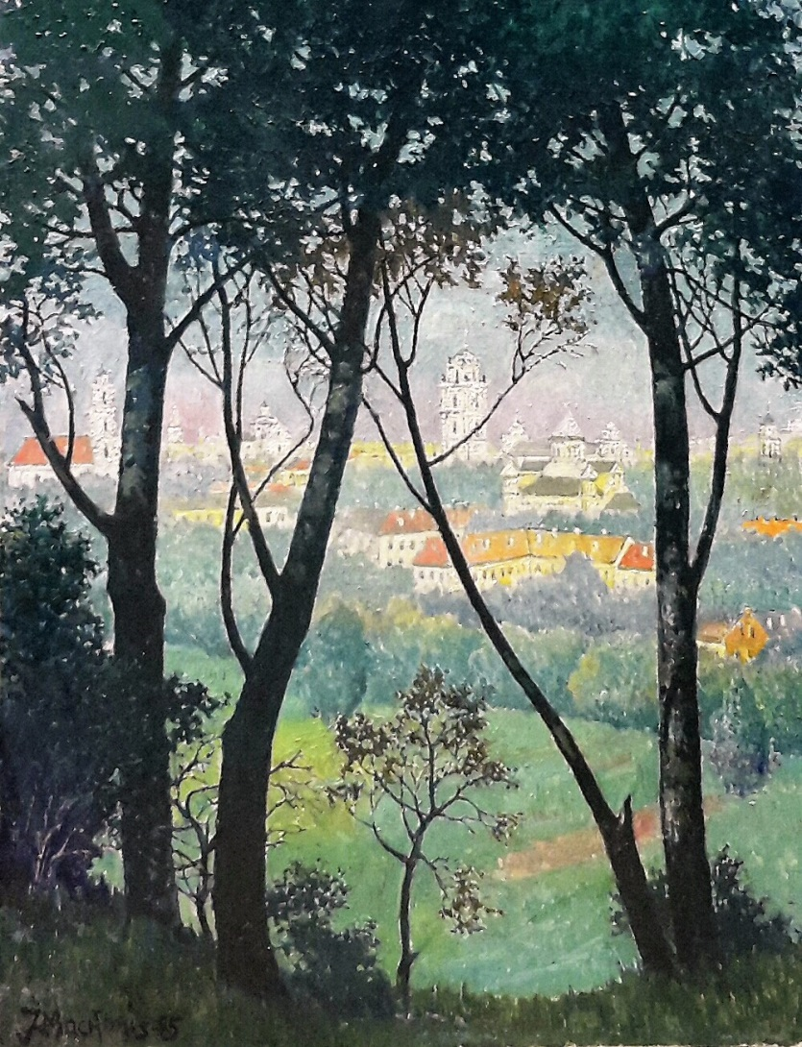
Jonas Mackonis

Slide 13
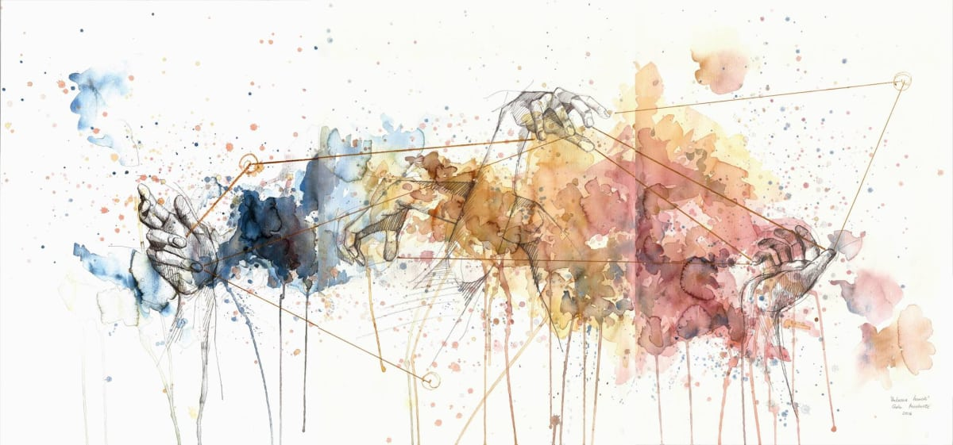
Greta Mockutė

