Slide 1
Geography-History Lesson
Ema, Emmi, Timur

Slide 2
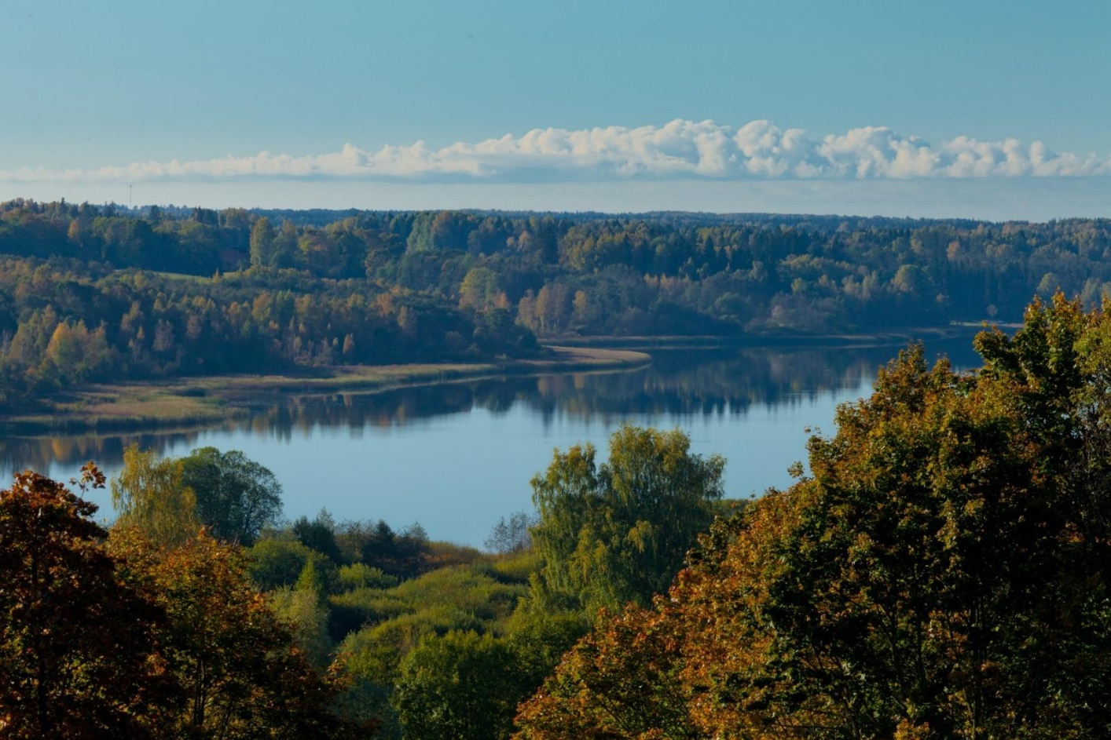
What have we done.
The first task
After we formed groups the teacher gave us maps and we had to name rivers, lakes, seas, oceans and that was the first task.
Lake Viljandi in Estonia

Slide 3
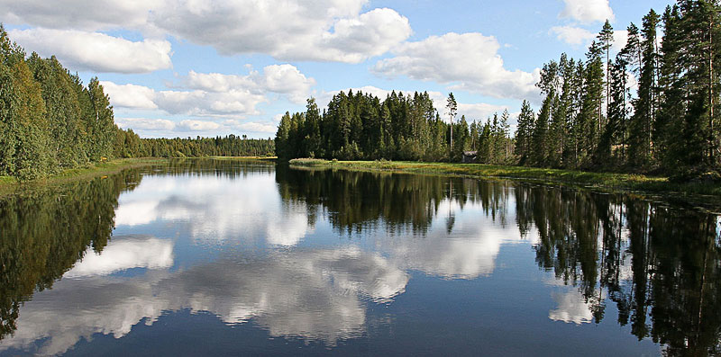
The second task
In the second task we had to recognize famous places of different countries, which were shown in the pictures on the screen.
The river Esse å in Finland.

Slide 4
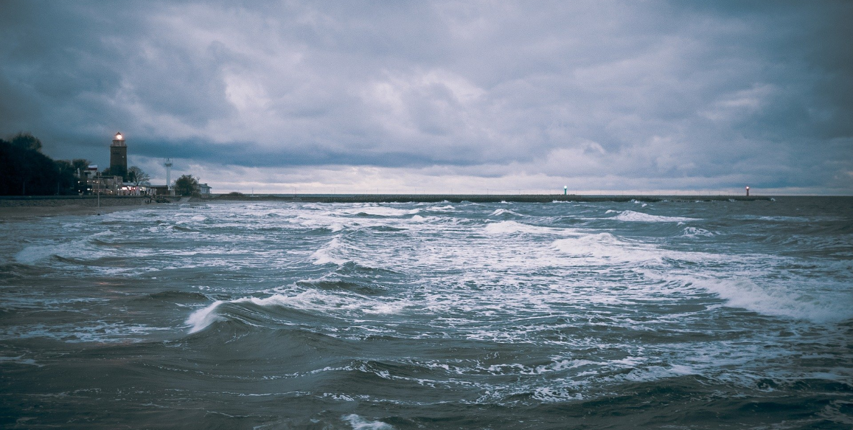
The third task
There were pictures on the screen again and we had to put places in the right order: seas, canals, waterfalls, lakes. We had to do it on the paper.
Everybody got points for each task and the team who got the
points won. The Baltic Sea
Baltic Sea

Slide 5
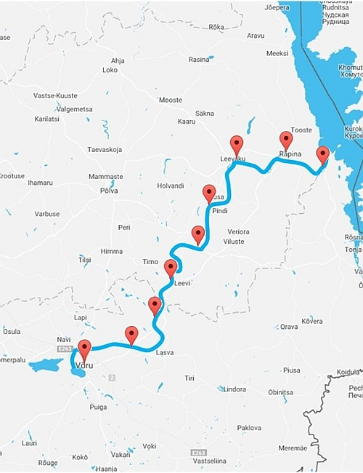
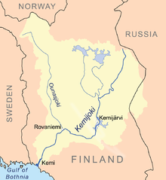
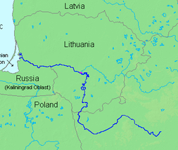
The longest and widest river
In Lithuania: the Nemunas 475km (Total 937 km)
In Estonia: the Vohandu 162 km
In Finland: the Kemijoki 550 km

Slide 6
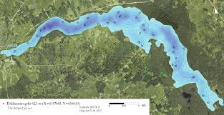
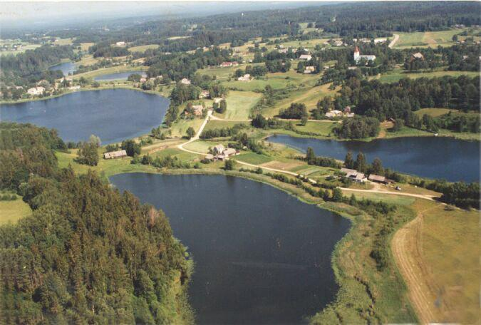
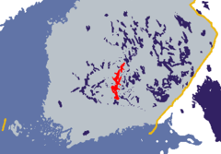
The deepest lakes
In Lithuania: Tauragnas 61,5m
In Estonia: Rouge 39 m
In Finland: Paijanne 95,4 m

Slide 7
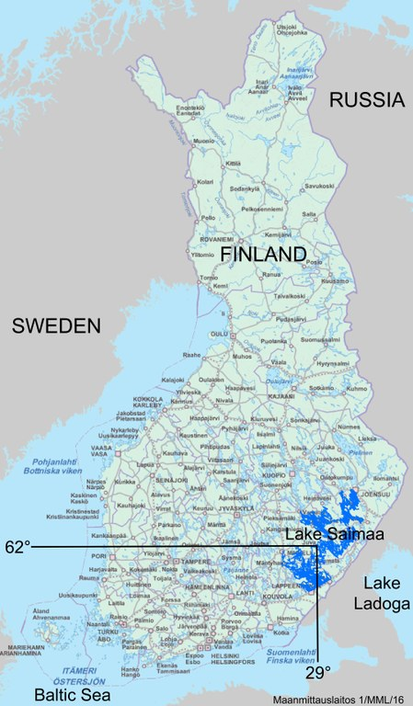
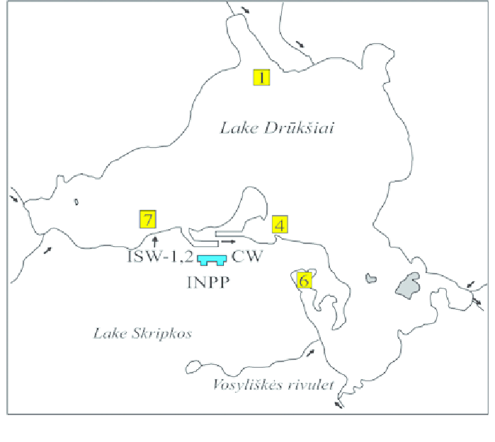
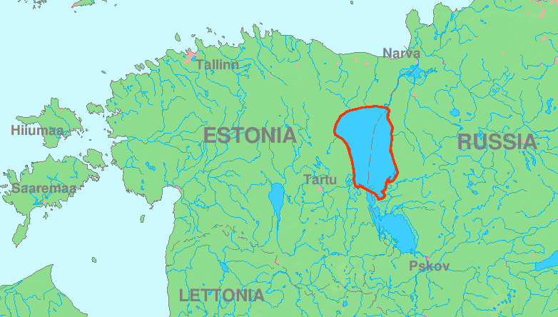
The biggest lakes
In Lithuania: Drūkšiai 44,8 km²
In Estonia: Peipsi 2,611 km²
In Finland: Saimaa 4400 km²

Slide 8
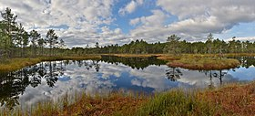
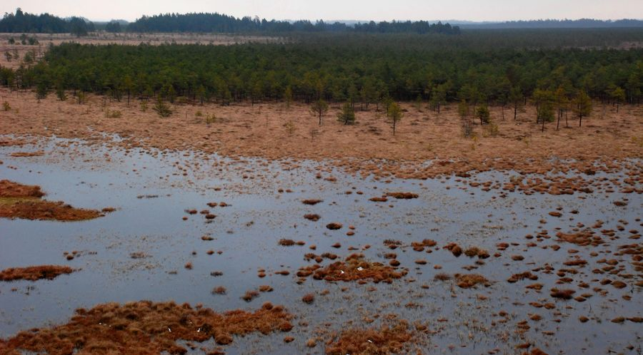
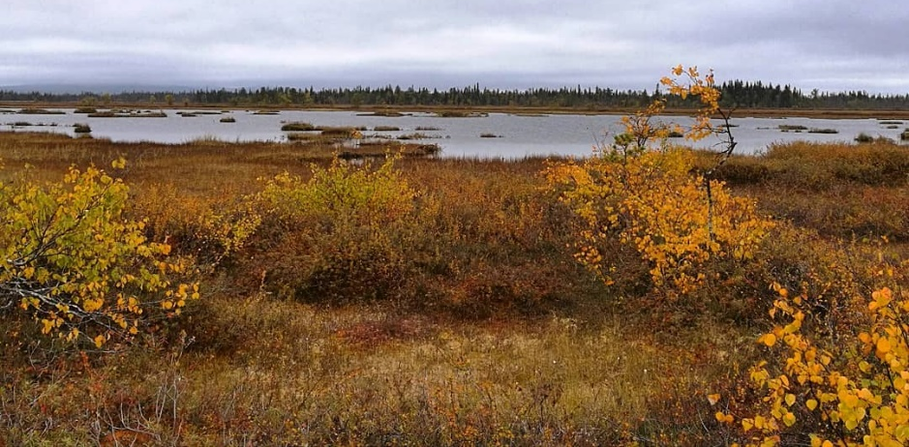
The biggest swamp
In Lithuania: Čepkeliai marsh 11,227 ha
In Estonia: Big Soo 25,7 km²
In Finland: Teuravuoma 7000 ha

Slide 9
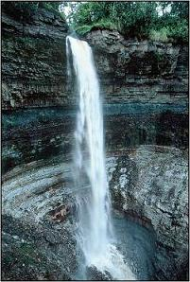
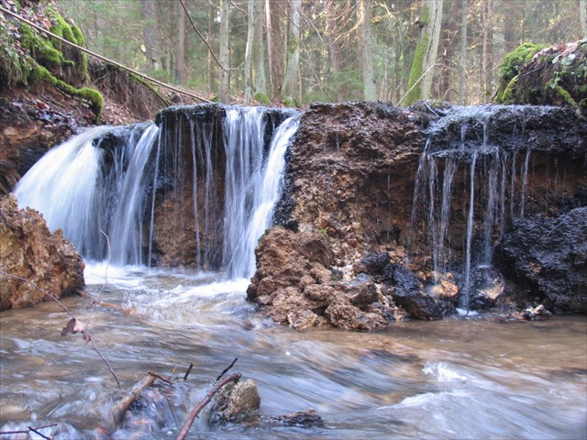
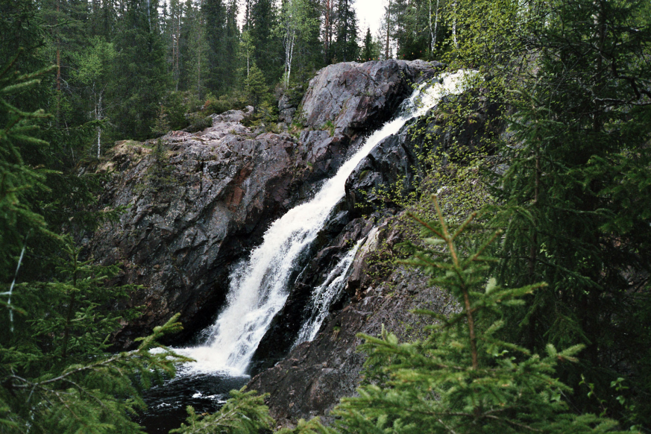
Waterfalls
In Lithuania: Vilsos river waterfalls 1,5 m
In Estonia: Kallaste 30 m
In Finland: Hepokongas 18 m

